Slide 1
Biomarker Questionnaires

Slide 2
This session’s objectives
Understand the flow of work for the interviewers and supervisors for collecting biomarker data
Learn how to prepare the biomarker questionnaire for the biomarker team
How to enter biomarker questionnaire once completed by technician

Slide 3
Main biomarker data flow in a cluster
Health techs conduct biomarker testing
Interviewers interview HHs identify eligible children and women
Interviewers
enter biomarker data
Interviewers fill out parts of biomarker questionnaire
CAPI supervisors complete parts of questionnaire
Supervisors enter biomarker data for the second time and fix discrepancies

Slide 4
Who completes what on biomarker questionnaire
Interviewers
Children's section
Line number and name (QB102)
Woman’s section
Line number and name (QB202)
Age (QB203)
Marital status (QB204)
Biomarker technician completes rest of biomarker questionnaire
Once questionnaires are completed, technician hands back to interviewer for entry
Interviewer enters paper biomarker questionnaires using their tablet

Slide 5
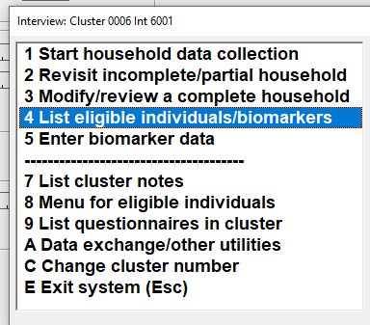
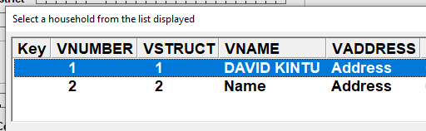
Listing eligible individuals
From interviewer
main menu:
Choose correct household to list:

Slide 6
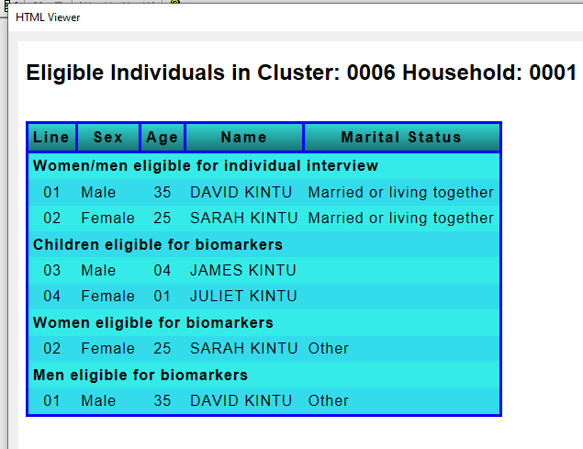
Listing example

Slide 7
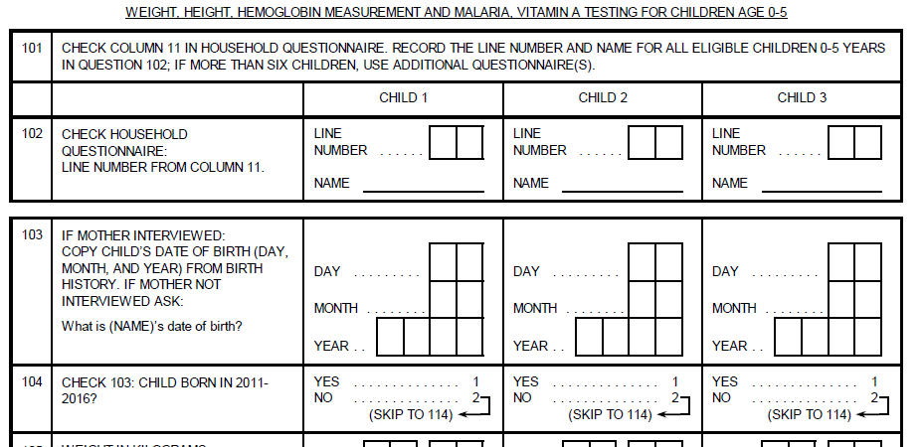
Interviewers: Fill out QB102 in biomarker questionnaire, in order to let the health tech can start his/her job
Eligible children
Notes:
Point to each question and ask people what should go in each
Interviewers fill in only 102!

Slide 8
Interviewers fills out initial information in biomarker form
Attention 1. Enter in order of line number
Eligible children
0
2
0
3
Kimberly
Jeffery
Notes:
Notice!!! In order of line number…
ASK – why is that important??
Answer… later when entering in CAPI, it requires/expects it in order.
ASK – what would happen if you entered it in the wrong order?
Answer… wrong barcode/blood sample assigned to wrong person!

Slide 9

Start to fill out biomarker questionnaire
Attention 1. Enter in order of line number
(contin.)
Top of page 2
Eligible children
Top of page 3
Top of page 4
Top of page X

Slide 10
Entering the biomarker questionnaire once completed
Receive completed paper biomarker questionnaires from technician
Interviewer enters questionnaires using their tablet
Household is not considered complete until biomarker entries are entered for all eligible members
Must co-ordinate with biomarker technician to ensure questionnaires completed in a timely fashion

Slide 11
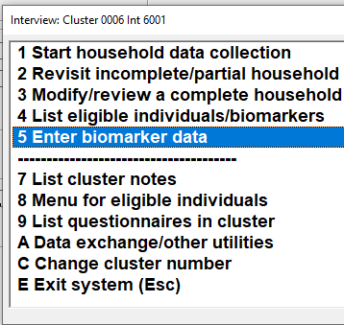
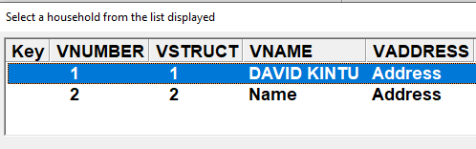
Entering the biomarker questionnaire once completed
Select option to enter biomarker data
…then select household

Slide 12
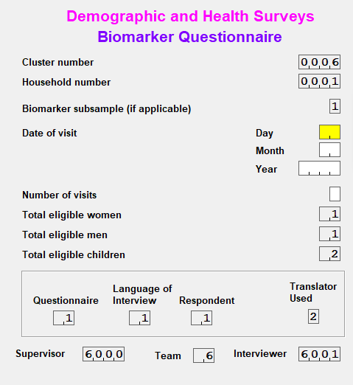
Entering the biomarker questionnaire once completed: Cover sheet
Enter date and number of visits from biomarker questionnaire cover sheet

Slide 13
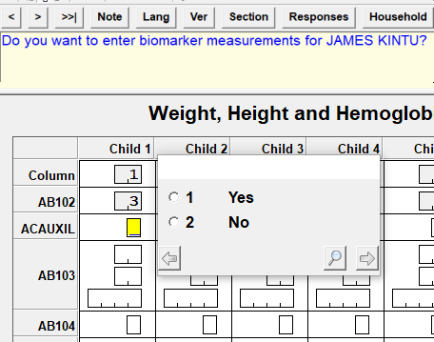
Entering the biomarker questionnaire once completed
Can choose whether to enter a given column: allows entry if not all entries completed

Slide 14
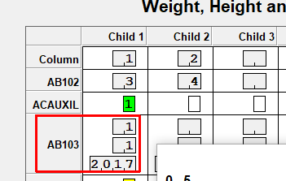
Entering the biomarker questionnaire once completed
Note: age of child will be automatically filled from the individual questionnaire if available

Slide 15
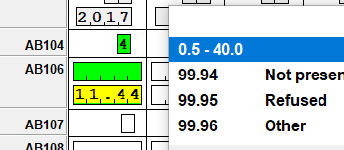
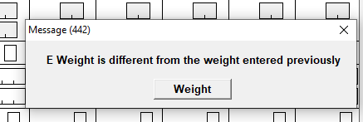
Entering the biomarker questionnaire once completed
Height and weight values must be double entered
Message will appear if the values
are not the same:
- check value in questionnaire
- go back and carefully key again

Slide 16
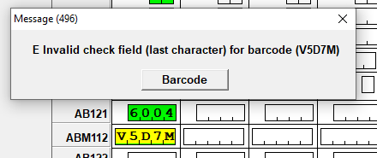
Entering Barcodes
Special format :
Letter+Number+Letter+Number+Letter
Eg V5D7L
Last letter is produced based on preceding four characters
Acts as a check on previous 4
Make sure you enter correctly
Be careful with ‘0’ (zero) versus ‘O’ (letter O) and ‘1’ (number) versus ‘I’ letter
Tablet will check correct values entered and generate message if the check fails
Carefully re-enter the code if message appears

